Slide 1
Unit -III
The 8255 Programmable Peripheral Interface

Slide 2
Syllabus
8255 PPI various modes of operation and interfacing to 8086.
Interfacing keyboard
Display
Stepper motor interfacing
D/A and A/D converter.

Slide 3
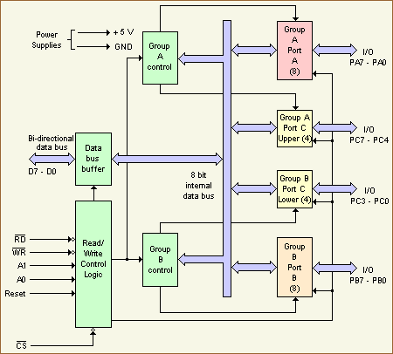
8255 Block diagram

Slide 4
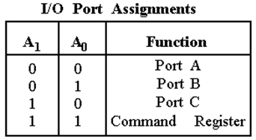

Slide 5
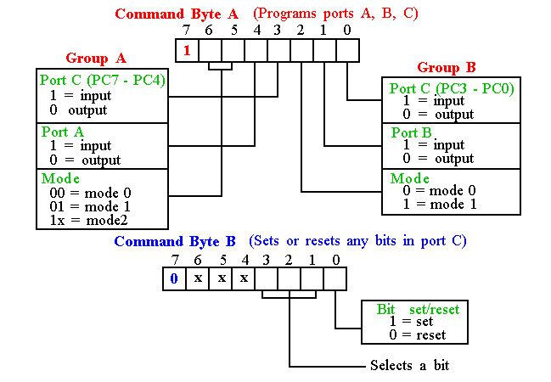
8255 programming & operation
Bit D7 of the control register specifies either I/O function or the Bit Set/Reset function. 8255 has three operation modes: mode 0, mode 1, and mode2.

Slide 7
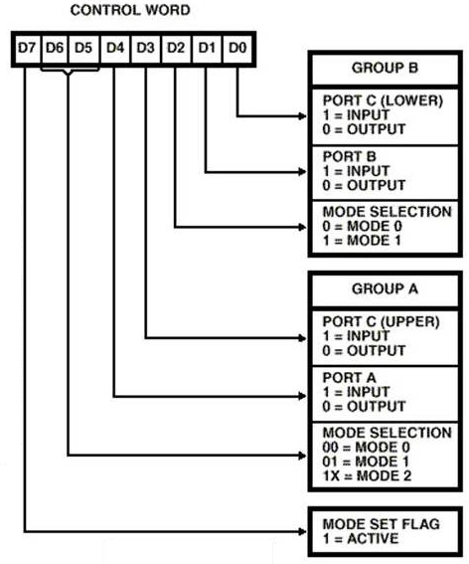

Slide 8
8255 programming & operation
Mode 0: ( I/O mode)
Ports A, B, and C can be individually programmed as input or output ports.
Port C is divided into two 4-bit ports which are independent from each other.
Mode 1:( Strobed I/O)
Ports A and B are programmed as input or output ports.
Port C is used for handshaking.
Port A -Input:
PC3 PC4 PC5 – control
PC6 PC7 – I/O
Port A -output:
PC3 PC6 PC7 – control
PC4 PC5– I/O
Port B input /output:
PC0 PC1 PC2– control mode1/mode2

Slide 9
8255 programming & operation
Mode2:(Strobed Bidirectional bus I/O)
Port A is programmed to be bi-directional.
Port C is for handshaking.
Port B can be either input or output in mode 0 or mode 1.
D7 | D6 | D5 | D4 | D3 | D2 | D1 | D0
1 | 1 | X | X | X | 1/0 | 1/0 | 1/0
I/O mode
Mode2 for PortA PortB I/O PC0-PC2 I/O
mode for portB

Slide 10
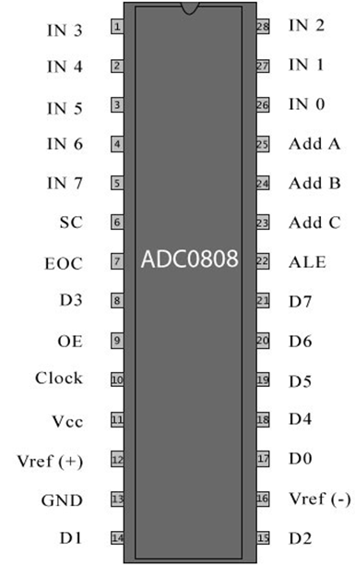
ADC interfacing

Slide 11
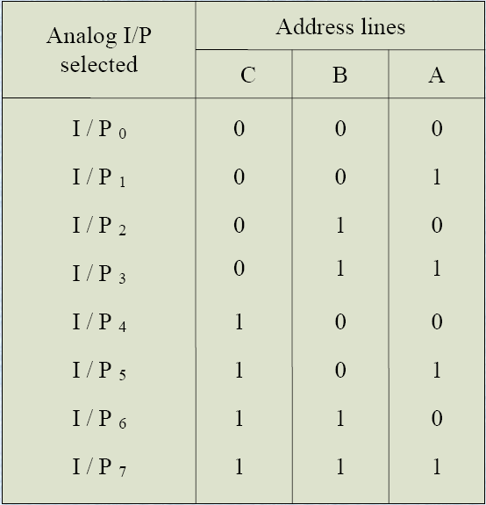
ADC interfacing

Slide 12
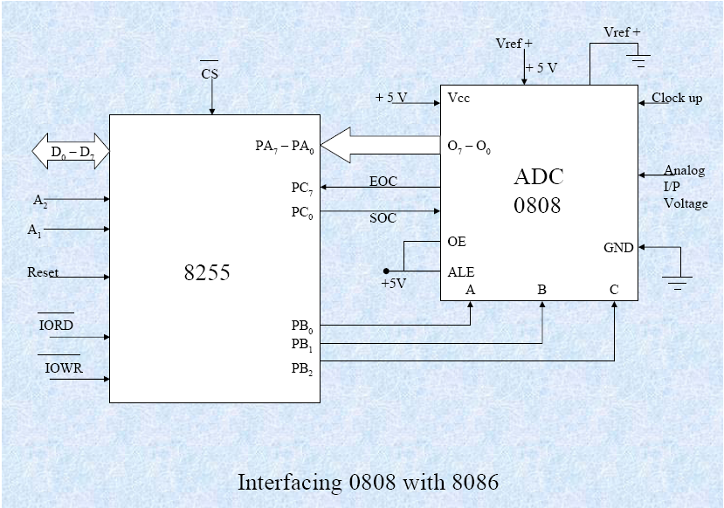

Slide 13
ADC interfacing
Algorithm:
Configure the ports.
Select the analog input.
Give start of conversion pulse to the ADC.
Wait till the EOC goes high.
If EOC=1, read digital data.

Slide 14
MOV AL, 98h ;initialise 8255 as
OUT CWR, AL
MOV AL, 02h ;Select I/P2 as analog
OUT Port B, AL ;input.
MOV AL, 01h ;Give start of conversion
OUT Port C, AL ; pulse to the ADC
MOV AL, 00h
OUT Port C, AL
WAIT: IN AL, Port C ;Check for EOC by
RCL AL,01H ; reading port C upper and
JNC WAIT
IN AL, Port A ;If EOC, read digital equivalent
HLT ;Stop.

Slide 15
Instruction timing and delay loops
 |  | Clock cycles
 | MOV CX, N | 4 = C₀
delay : | NOP | 3
 | NOP | 3 = C_{L}
 | LOOP delay | 17 or 5

Slide 16
Instruction timing and delay loops
C₀ : No. of cycles for the instructions that execute only once.
C_{L} : total no. of cycles for the instructions inside the loop.
C_{T}: no. of clock cycles to produce the desired delay.
ex: for 1ms delay C_{T} = 1ms = 5000
(assuming 5Mhz freq.) 1/5Mhz

Slide 17
Instruction timing and delay loops
C_{T} = C₀ + N(C_{L})-12
N = (C_{T} - C₀ + 12)/C_{L}
N = (5000 – 4 + 12)/(3+3+17)
= 0DAH

Slide 18
Instruction timing and delay loops
Calculate the value of N for the following sequence with a delay value of 50ms.(assuming operating freq of 10Mhz)
 |  | Clock cycles
 | MOV CX, N | 4
delay : | DEC CX | 2
 | JNZ delay | 16 or 4

Slide 19
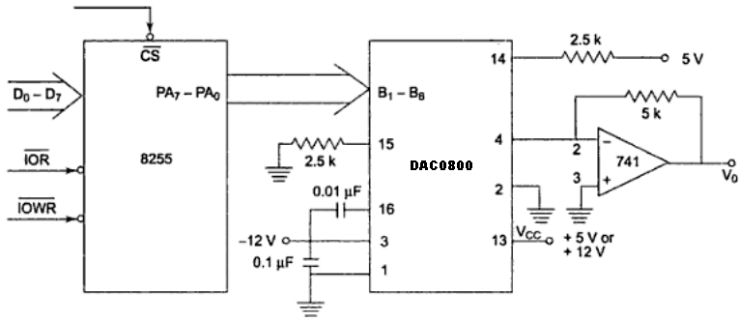
DAC interfacing

Slide 20
DAC interfacing
Interfacing DAC 0800 with an 8086 CPU
running at 8MHZ and write an assembly language program to generate a saw tooth waveform of period 1ms with Vmax 5V.

Slide 21
MOV AL,80h ;make all ports output
OUT CWR, AL
again: MOV AL,00h ;start voltage for ramp
back : OUT PA, AL
CALL delay
INC AL
CMP AL, 0FFh
JB back
JMP again
Delay PROC NEAR
MOV CX,03H ;delay for 1 ms
LOOP $
Delay ENDP

Slide 22
Keyboard interfacing
Types of switches:
Mechanical switches
Membrane switches
Capacitive switches
Hall effect switches

Slide 23
Keyboard interfacing
Three major tasks:
Detect a key press.
Debounce the key press.
Encode the key press.

Slide 24
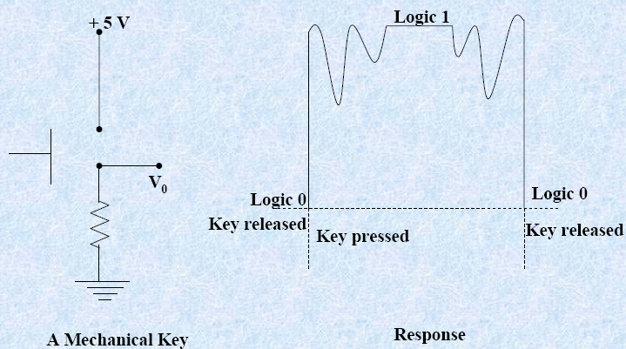
Key debounce

Slide 25
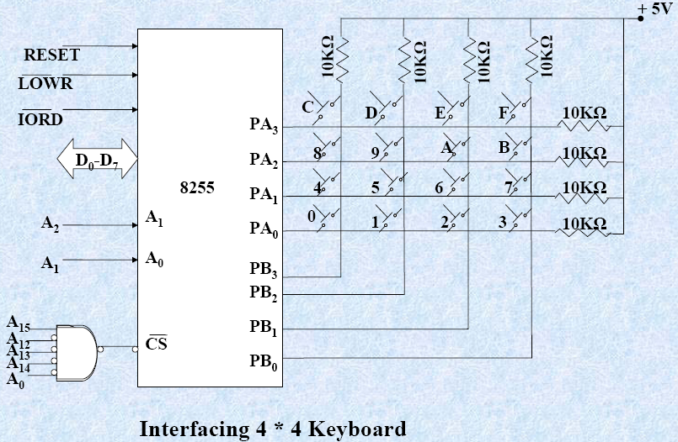

Slide 26
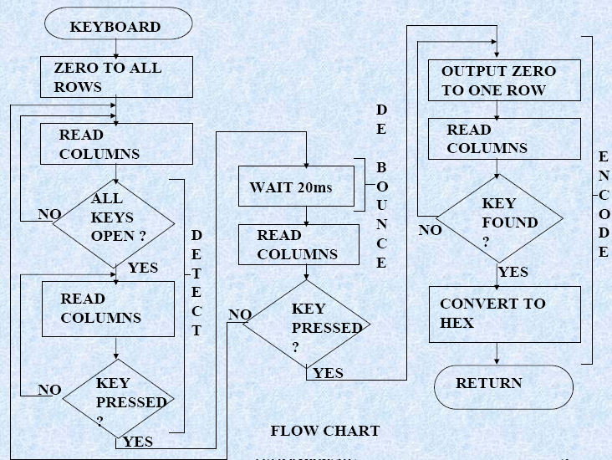

Slide 27
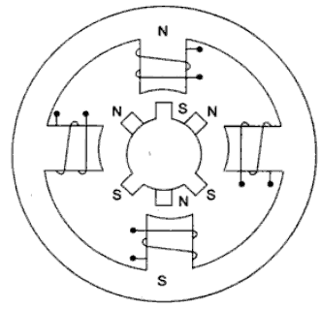
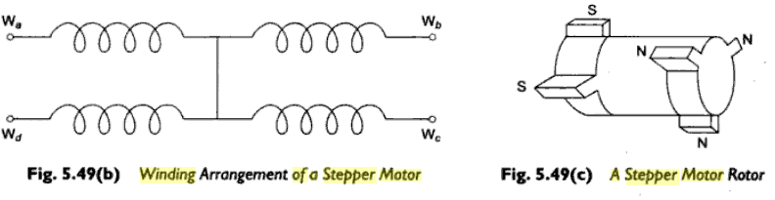
Stepper motor interfacing

Slide 28
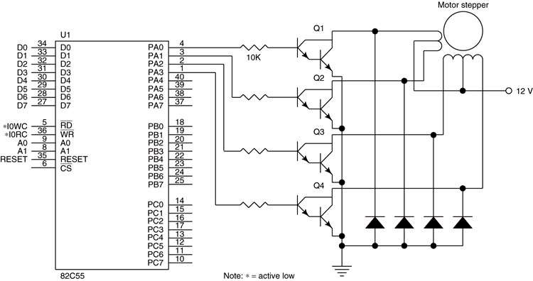
Stepper motor interfacing

Slide 29
Stepper motor interfacing
Motion | Step | A | B | C | D
Clock wise | 1 | 1 | 0 | 0 | 0
 | 2 | 0 | 1 | 0 | 0
 | 3 | 0 | 0 | 1 | 0
 | 4 | 0 | 0 | 0 | 1
 | 5 | 1 | 0 | 0 | 0
Anti clockwise | 1 | 1 | 0 | 0 | 0
 | 2 | 0 | 0 | 0 | 1
 | 3 | 0 | 0 | 1 | 0
 | 4 | 0 | 1 | 0 | 0
 | 5 | 1 | 0 | 0 | 0

Slide 30
Stepper motor interfacing
Design a stepper motor and write an ALP to rotate shaft of 4-phase stepper motor.
In clock wise 5 rotations
In anti clock wise 5 rotations
The port A address is 0740h. The stepper motor has 200 rotor teeth. PA0 drives winding Wa(winding a), winding Wb, and so on. It has an internal delay of 10ms.

Slide 31
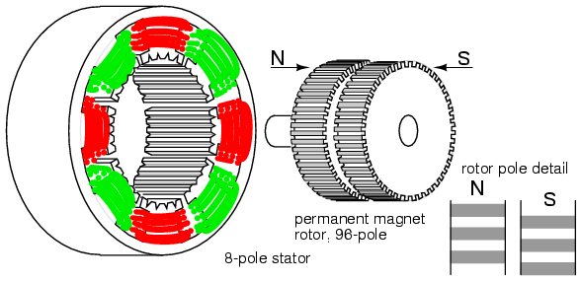
Stepper motor interfacing

